Slide 1
Sustaining the Golf Surge:
WHAT GOLFERS REALLY WANT

Slide 2

The Back-to-Normal Barometer
ORIGINS
2001 Golf Digest Companies Travel Confidence Index
  Measured golfer attitudes vs. the affluent general public
    Willingness to travel
    Willingness to spend on luxuries and discretionary purchases
    Consumer attitudes on personal finance, the prospects for retirement and the U.S. economy
2009-Present Sports and Leisure Research Group Golfer Omnibus Work
  Presented annually at PGA Merchandise Show Wednesday Breakfast tracks forward looking golfer perceptions on the year ahead in:
    Overall participation levels
    Outlook on planned spending across hard goods, soft goods and travel categories
    Golfer attitudes on personal finance, discretionary spending and the U.S. economy
    Contemporary issues in golf

Slide 3










The Back-to-Normal Barometer
AMERICA STANDS AT AN INFLECTION POINT
We just completed the fifteenth wave of a twice-monthly tracking study that listens to the voice of the consumer
  Survey research
  In-depth interviews
  Social media analyses
  Online dial tests
        What’s it going to take to bring consumers back?
        Where is the greatest pent-up demand?
        What will the new normal look like?
How do various sports and leisure activities navigate through these times?

Slide 4
CONTEXT: Respondents Actively Engage
Percent who have actively participated in this activity in the past 12 months
n=502, Back to Normal Barometer, Oct. 21, 2020

Slide 5
Confidence Barometer Matches All-Time High
Back to Normal Barometer, Oct. 21, 2020

Slide 6



Health crisis is Top Personal & Societal Concern
Back to Normal Barometer, Oct. 21, 2020

Slide 7
Stress Levels Continue To Rise Over The Past Month
Percent much more stressed
Back to Normal Barometer, Oct. 21, 2020

Slide 8
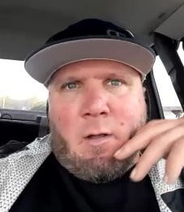
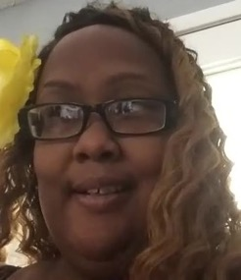
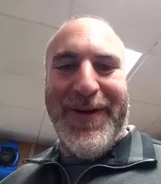
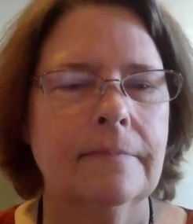
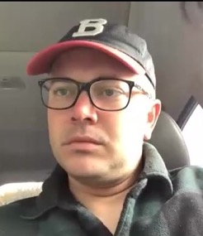
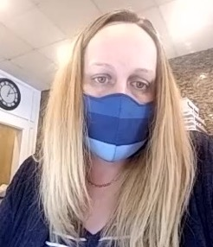
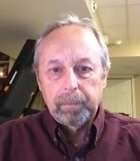
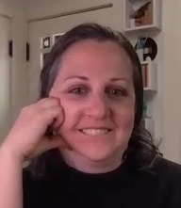
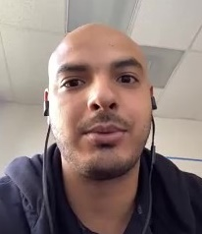
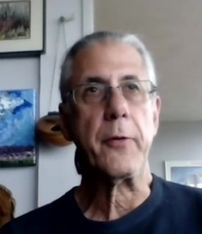
In-Depth Interviews
What they’re saying now about covid

Slide 9
Covid: An increasing threat locally
10 of 10 say their COVID-19 threat locally is increasing
  Numbers going up, news reports
  Mandates/warnings are increasing
  Logic – colleges/schools open, colder weather, pandemic fatigue
They’re concerned people are losing focus, which could lead to spikes
  “(COVID-19) is still here, but we’re getting complacent…We’re just ready to get back to normal, but I don’t think it’s time to get back to normal.”
  “We all got a little loose (about precautions) over the summer because things were a lot calmer and it’s time to button back up.”
Globally, many don’t have a good sense of how the world is doing

Slide 10
And “covid fatigue” has set in
A survey high 38% strongly agree COVID is less of a threat than it was this summer
A survey high 43% strongly agree that it’s time for the country to re-open for business
Those with a desire to see those areas with high rates of COVID re-closed hits Barometer low of 54%

Slide 11
Strong Desire to Get Back to Working at an Office
HOW MUCH DO YOU WANT TO RETURN TO WORKING AT AN OFFICE OUTSIDE YOUR HOME?
Back to Normal Barometer, Oct. 21, 2020

Slide 12
Compared to a Month Ago, More Expect a Sooner Open
Using a scale from 1-10, where 10 indicates that from the standpoint of COVID-related restrictions, safety protocols, business closures, or capacity limitations, the country will be up and running as it was pre-pandemic, 5 indicates that things will be no different than they are today and 1 indicates we will be in full lockdown, where do you anticipate that the country will be...
Percent who think the country will be up and running as it was pre-pandemic
n=498, Sept. 23, 2020; n=502, Oct. 21, 2020

Slide 13
And Despite News, Willingness To Engage Continues to Rise
[Among those who have done this activity in the past 12 months:] For each of the following activities, please indicate which of the following conditions is closest to your current point of view: Recently active + Ready to go
Back to Normal Barometer, Oct. 21, 2020

Slide 14
With Core Activities, Men & Women Similarly Engage
Percent who fit this category
Visit a Retail Store
Visit a Doctor’s Office
Visit a Dentist’s Office
n=502, Back to Normal Barometer, Oct. 21, 2020

Slide 15
But with Optional Activities, Men are Far More Engaged
Percent who fit this category
Fly
Commercially
Stay at a Hotel or Resort
Attend a Live Sporting Event
Visit a
Theme Park
Take a Cruise
Vacation
Attend a Conference or Convention
n=502, Back to Normal Barometer, Oct. 21, 2020

Slide 16
More Than Half of Golfers are Working from Home
ARE YOU PRESENTLY WORKING FROM HOME OR IN A DEDICATED WORKPLACE?
n=129, Back to Normal Barometer, Nov 19, 2020

Slide 17
A Majority See COVID Cases Increasing Over The Coming Months.
WHEN IT COMES TO THE NUMBER OF NEW DAILY COVID-19 CASES IN THE U.S. OVER THE NEXT TWO MONTHS, DO YOU EXPECT THE NUMBER TO...
n=598, Back to Normal Barometer, November 19, 2020

Slide 18
…And It’s Undermining Their Willingness To Travel
THE POSSIBILITY OF A SECOND WAVE OF COVID-19 CASES IS AFFECTING MY WILLINGNESS TO TRAVEL IN COMING MONTHS.
n=217, Back to Normal Barometer, July 8, 2020

Slide 19
Not Putting Their Guard Down
LESS THAN HALF SEE THE PANDEMIC AS LESS OF A THREAT THAN IT WAS THIS SUMMER
I'm concerned that there will be a second wave of COVID-19 outbreak, requiring event cancellations and lockdowns within the next six months.
55% of golfers are are much more concerned about an outbreak in their community than they were a month ago
n=598, Back to Normal Barometer, November 19, 2020

Slide 20
Significantly More Golfers Plan to Get Vaccinated vs. Public at Large
I WILL DEFINITELY GET A COVID 19 VACCINE WHEN IT IS AVAILABLE
n=588, Back to Normal Barometer, November 19, 2020

Slide 21
Light at the End of the Tunnel by Spring
WHEN DO YOU ANTICIPATE THAT A COVID 19 VACCINE WILL BE WIDELY AVAILABLE IN THIS COUNTRY?
n=588, Back to Normal Barometer, November 19, 2020

Slide 22
Amidst Worry, YOU Need To Have Their Backs
Wisdom, certainty, and trust are in short supply
Americans don’t believe others are being as diligent in their adherence to safety protocols as they are
In the absence of clear guidance, one’s confidence to re-engage is tied to an ability to control the health risk of a given experience
Your challenge: Can you enhance the semblance of personal control? Can you provide the certainty people crave?
  Message: “You don’t have to worry about others’ behavior; we’ve got you covered.”

Slide 23
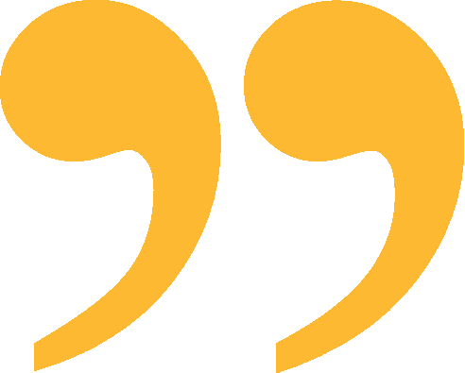
Example of Giving Certainty & Getting It Right
At the hotel, they did the extra guidelines and took the effort to have extra cleaning, make sure [there was] spacing. The staff and everyone was wearing masks. It had a pool [at] the place that we stayed, and they had it set up that you would schedule your time there. That way people weren’t interacting too much. It’s kind of what I was expecting that they would do in a case like that. [Their attitude was,] ‘We’re going to try and stay open, but we’re going to follow the guidelines how we’re supposed to.’ It was a great experience overall.
– Nick (Male, age 36, California)

Slide 24


Golf 20/20 Meets Golf 2020

Slide 25

Golf 20/20 Meets Golf 2020
COVID HAS SPAWNED A POTENTIAL NEW GOLF BOOM?
Anecdotally and empirically we see full tee sheets
  Amidst reports of increased play from existing golfers
  and renewed trial from lapsed and never before players
Golf has successfully positioned itself in the short term
  as one of the few viable options for outdoor recreation
  AND socialization
    Bars are closed—But not the drink cart!
  Adhering to safety and sanitization protocols
  An “oasis from the chaos.”
WHAT DOES THE LATEST BAROMETER DATA TELL US?

Slide 26
Growth in Participation and Anticipation Continues its Positive Trend
Played Golf Within The Past Two Weeks
Planning to Play Within The Next Week
Top 3 Box Summary

Slide 27
The 80/20 Rule—Our Most Engaged Golfers are More Apt to be Playing
HAVE YOU PLAYED GOLF WITHIN THE PAST TWO WEEKS?
CASUAL
CORE
AVID

Slide 28
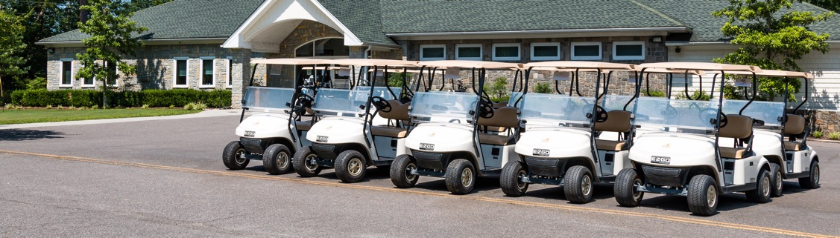
Golf Facilities Have Done an Excellent Job of Meeting Golfer Expectations for Health Protocols
THE COURSE WHERE I MOST RECENTLY PLAYED, HAS DONE AN EXCELLENT JOB OF FOLLOWING NEW SAFETY AND SANITIZATION PROTOCOLS
TOP 3 BOX SUMMARY

Slide 29
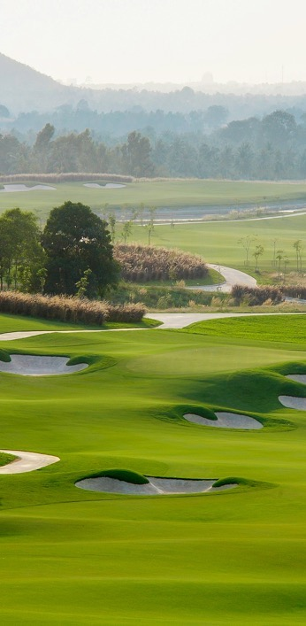
Golf Has Been An Oasis from the Chaos for a Majority of Golfers During the Pandemic
AGREEMENT

Slide 30
Golfers Recognize the Game’s Health Benefits and it is Leading to Greater Trial
AGREEMENT

Slide 31
Golfers are Self Reporting Comparatively Higher Rounds Per Capita Than A Year Ago
WHICH OF THE FOLLOWING BEST DESCRIBES YOUR GOLF ACTIVITY SINCE COURSES RE-OPENED IN YOUR AREA DURING THE PANDEMIC?

Slide 32
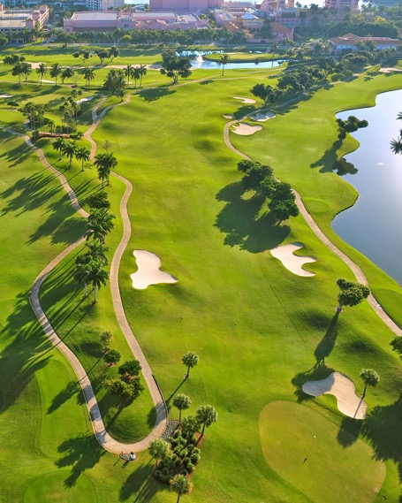
Why Golfers are Playing More….It’s Situation Specific
WHY ARE PEOPLE PLAYING MORE GOLF NOW?

Slide 33

Why Golfers are Playing More….It’s Situation Specific
AND WHICH OF THESE, DO YOU FEEL IS THE MOST SIGNIFICANT REASON WHY PEOPLE ARE PLAYING MORE GOLF?

Slide 34
Golfers Bullish about the Sustainability of the Participation Surge
THOSE WHO HAVE BEGUN TO PLAY MORE GOLF, THIS SEASON, WILL BE PLAYING JUST AS MUCH OR MORE GOLF, A YEAR FROM NOW.
TOP 3 BOX
AGREEMENT
ASSUMING THERE WAS A COVID 19 VACCINE...WHAT BEST DESCRIBES THE AMOUNT OF GOLF THAT YOU WOULD LIKELY PLAY NEXT YEAR, RELATIVE TO IN THIS YEAR (2020)?
CASUAL
CORE
AVID

Slide 35
Golfers Continue to Show Greater Overall Resilience and Optimism vs. the U.S. Population in Total
TOP 3 BOX AGREEMENT

Slide 36
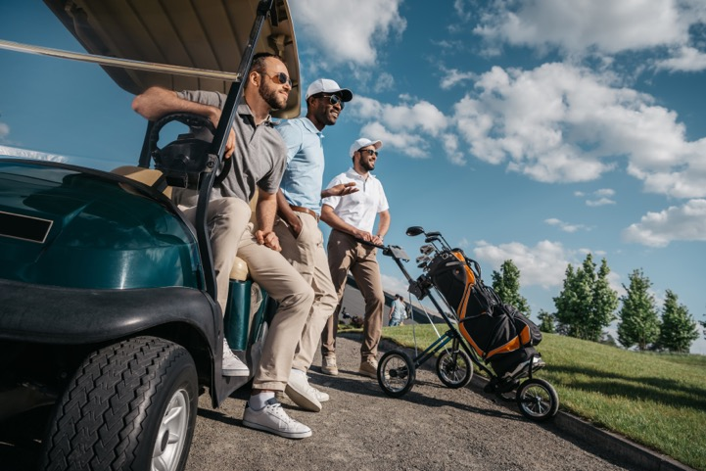
Golfers Won't Stop After the Pandemic
ASSUMING THERE WAS A COVID 19 VACCINE...WHAT BEST DESCRIBES THE AMOUNT OF GOLF THAT YOU WOULD LIKELY PLAY NEXT YEAR, RELATIVE TO IN THIS YEAR (2020)?

Slide 37
Golfers Won't Stop After the Pandemic
THINKING ABOUT THE GOLF EQUIPMENT PURCHASES THAT YOU MAY HAVE MADE THIS YEAR HOW DOES THIS COMPARE TO YOUR ANTICIPATED PURCHASES OF GOLF EQUIPMENT IN 2021?

Slide 38
Golfers Are More Likely to be “Recently Active” or “Ready to Go” vs. Sports Fans
STAY AT A HOTEL OR RESORT
GOLFERS
SPORTS FANS

Slide 39
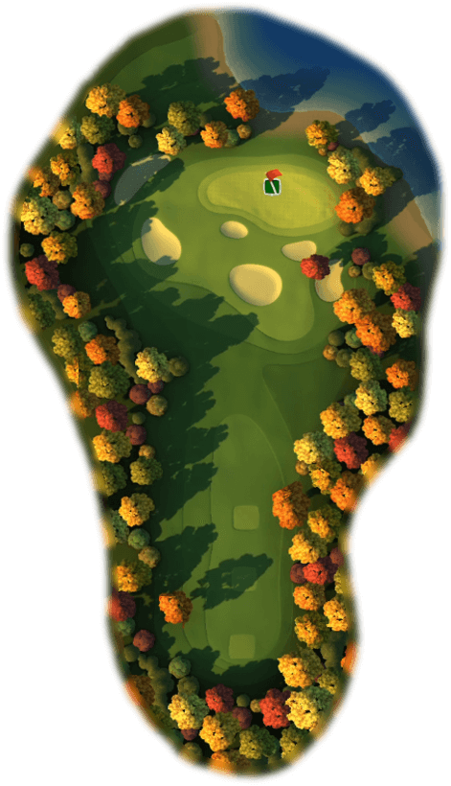
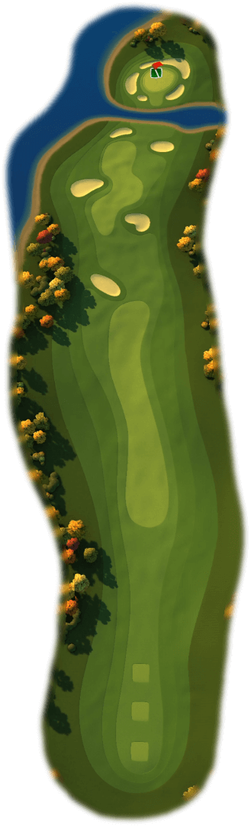
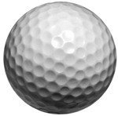
Implications
SHORT TERM
A Significant Opportunity to Create Enduring Connections
LONG TERM
Remember the Short Lived Tiger Boom
Strike while the iron is hot
Be welcoming and create the right experience
Connect with your customers
Think broadly about the competitive set

Slide 40
Sustaining the Golf Surge:
WHAT GOLFERS REALLY WANT

